Slide 1




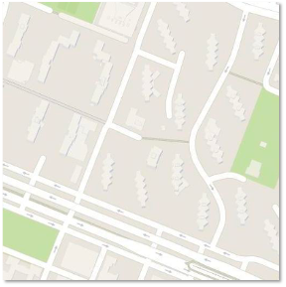
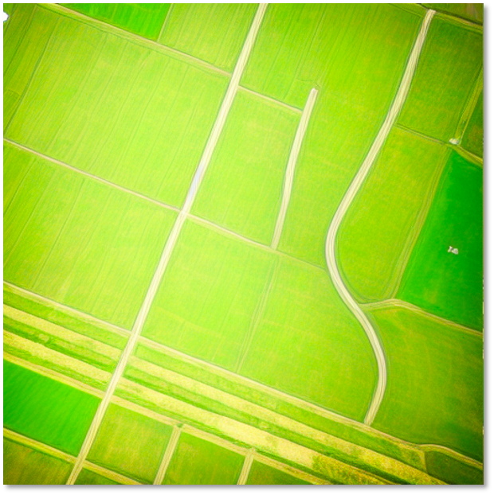
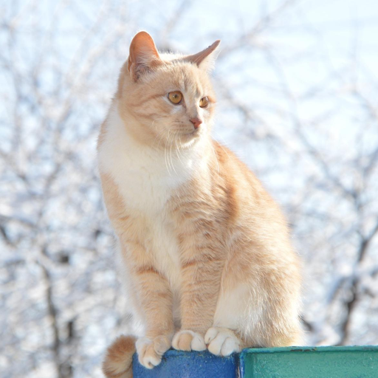



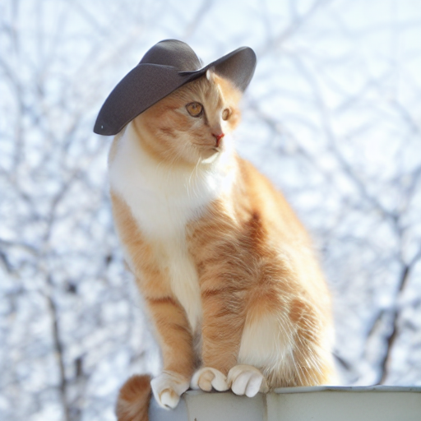
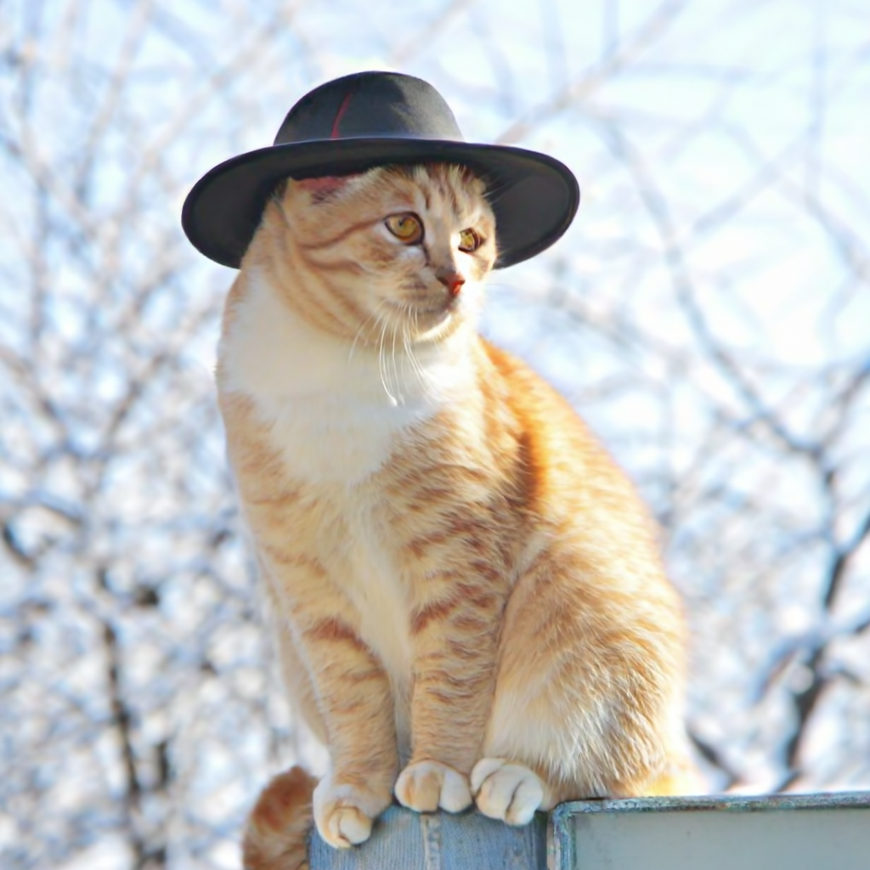
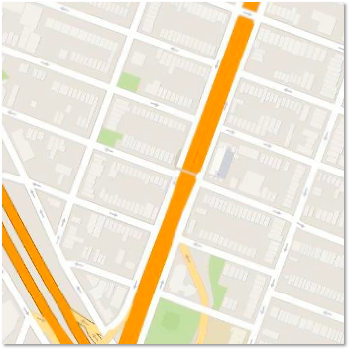
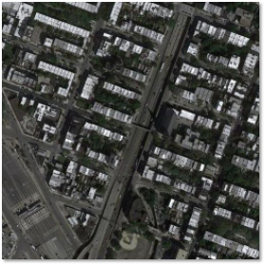
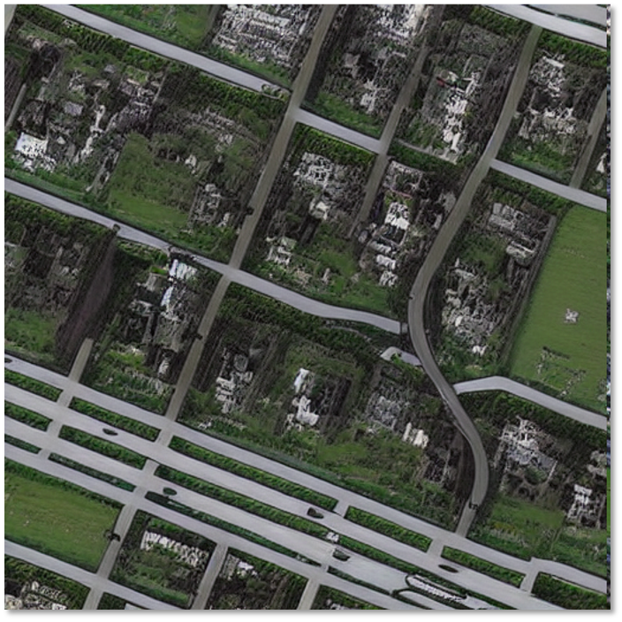
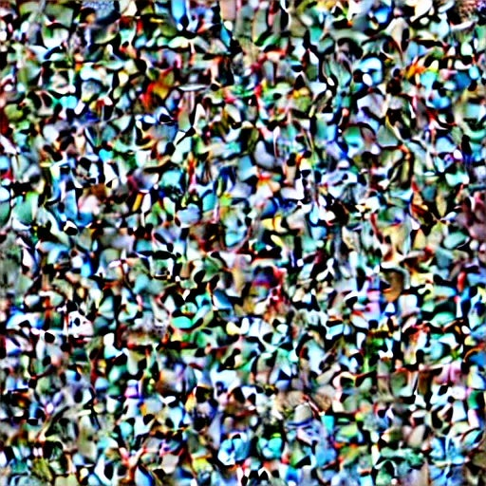
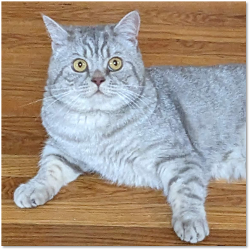
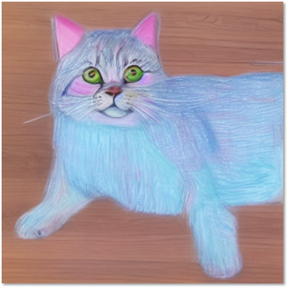
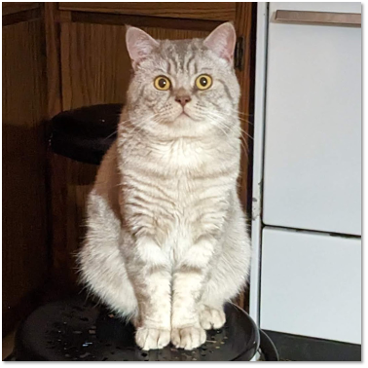
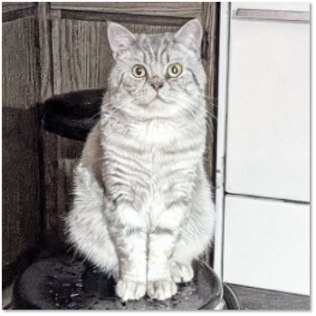
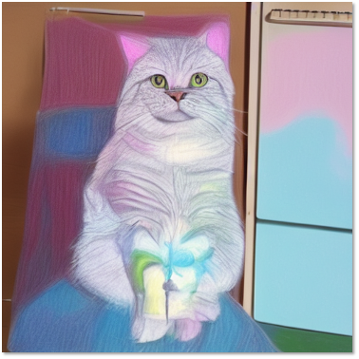
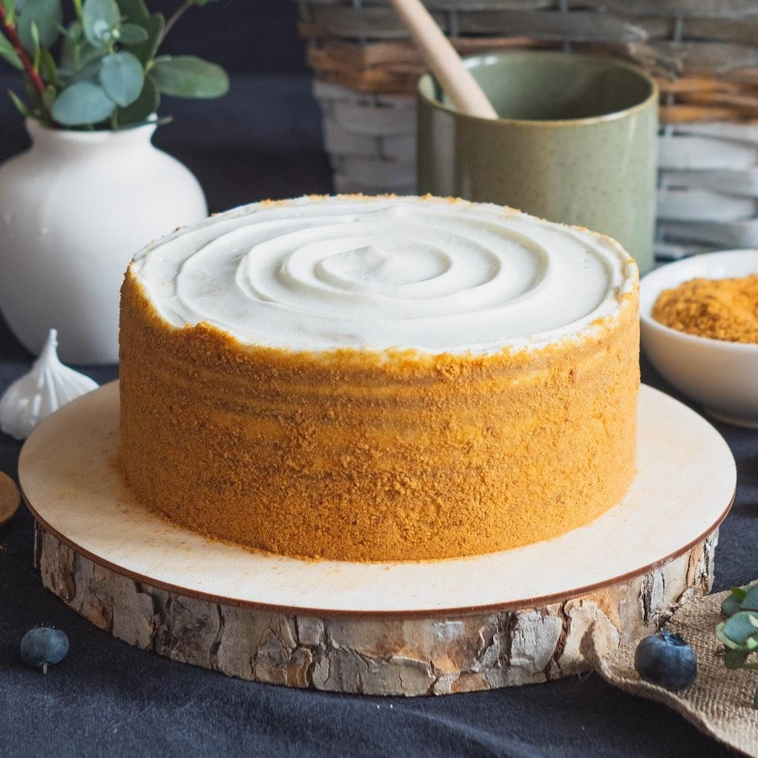
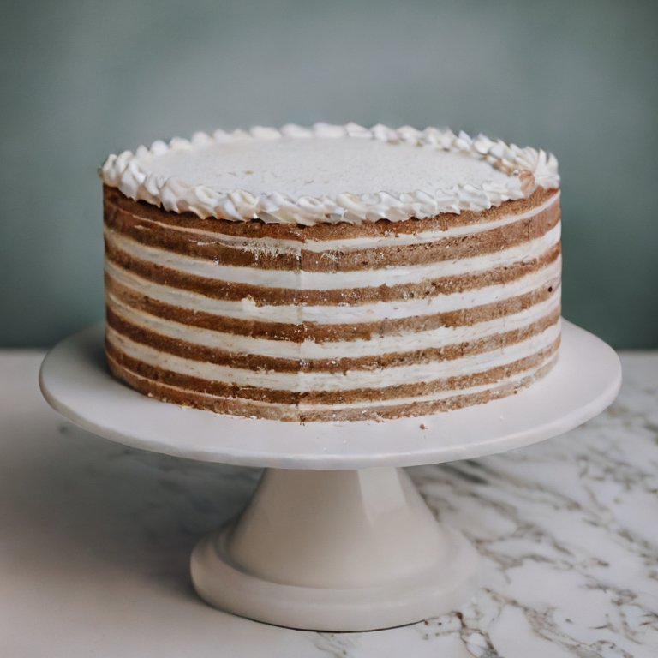
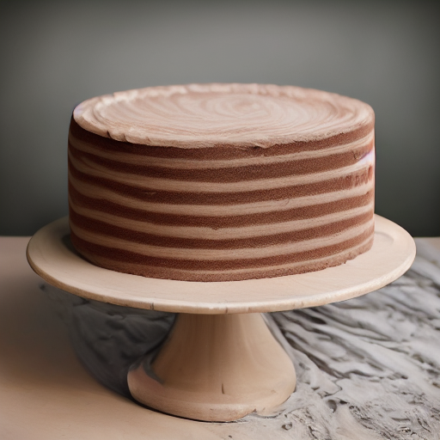

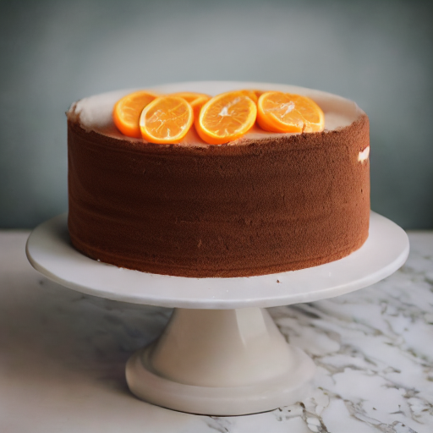
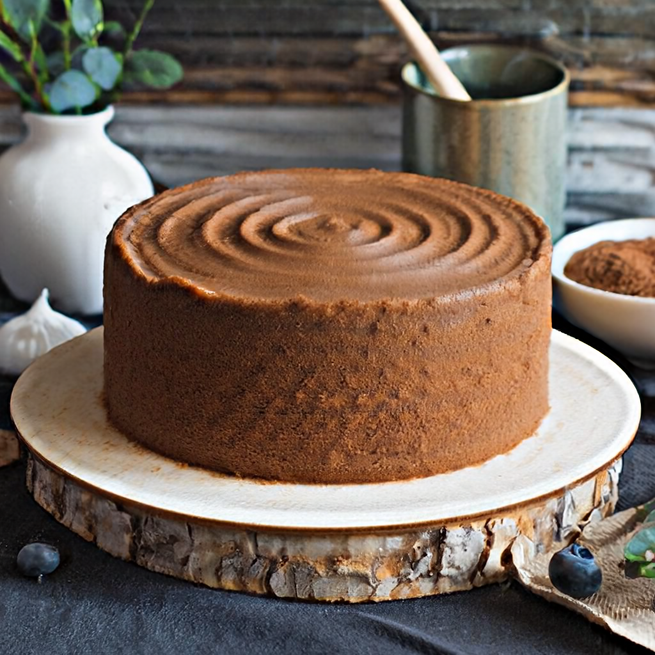
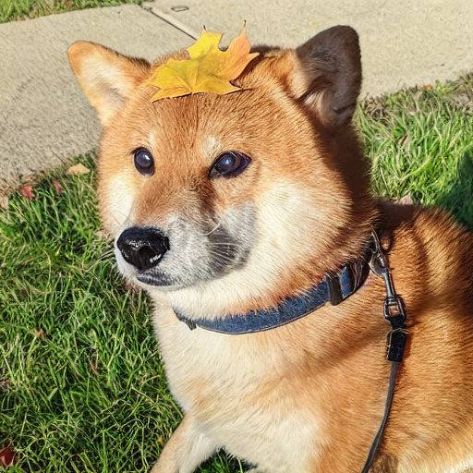
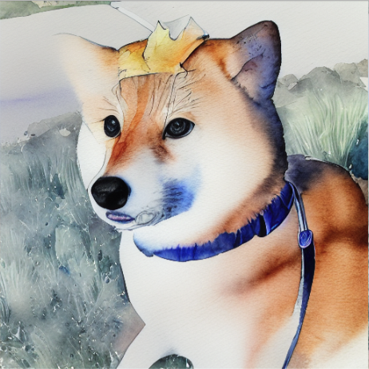
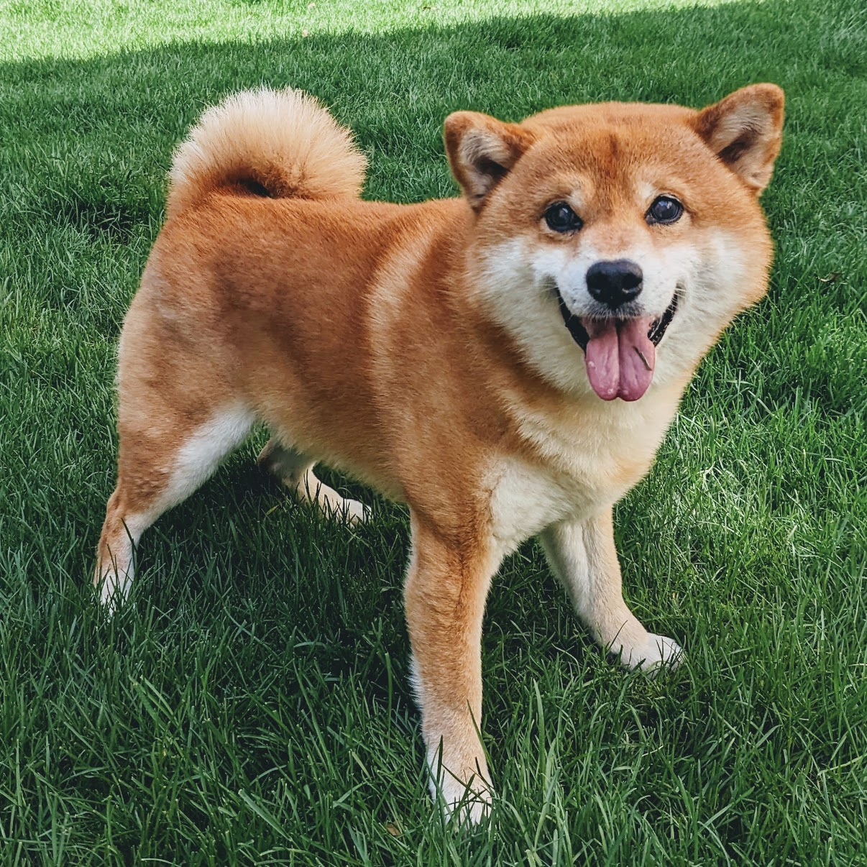
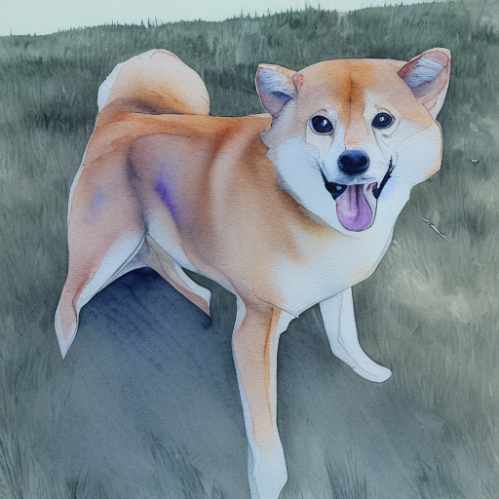
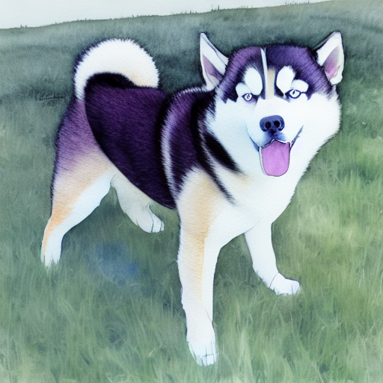
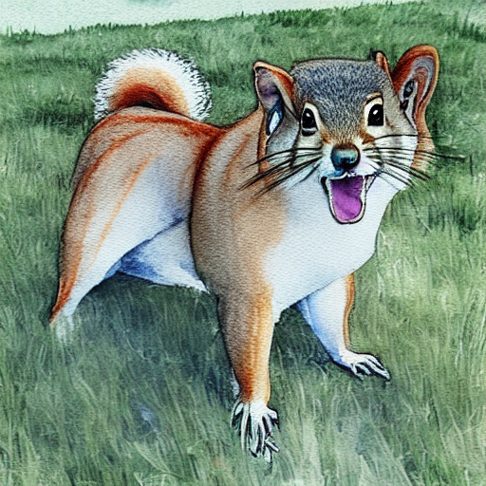
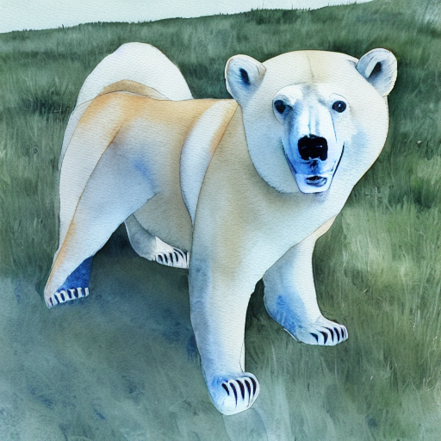
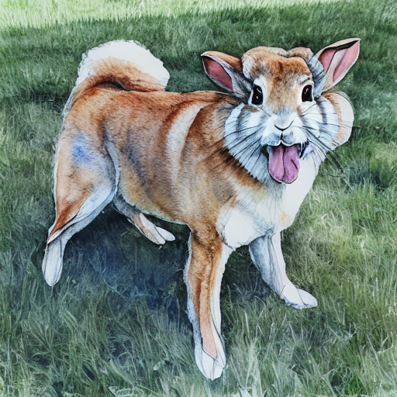
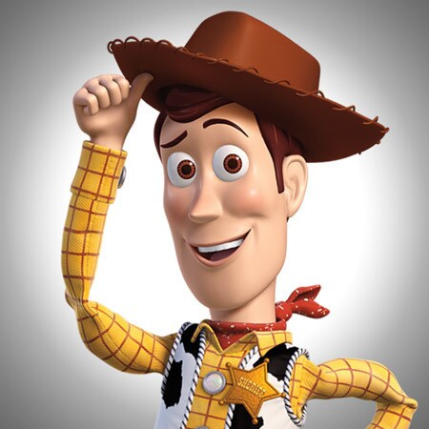
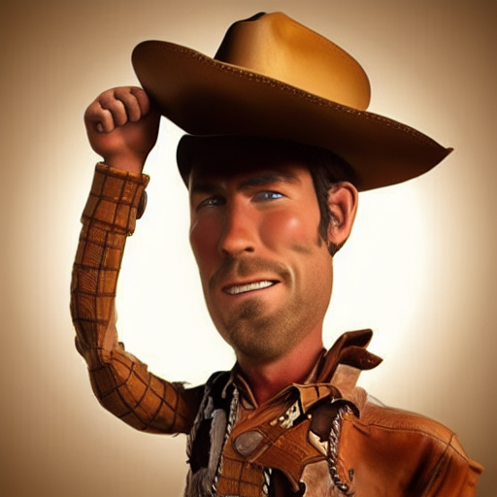
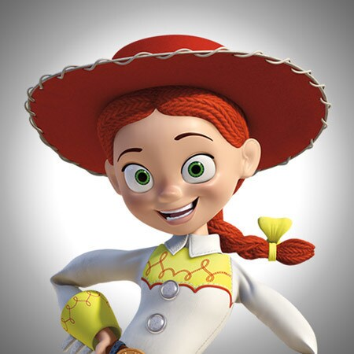
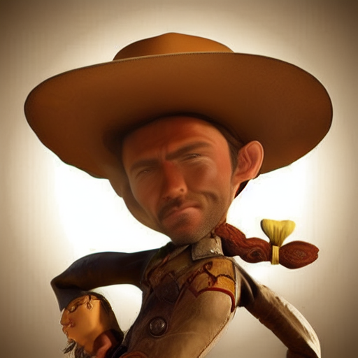
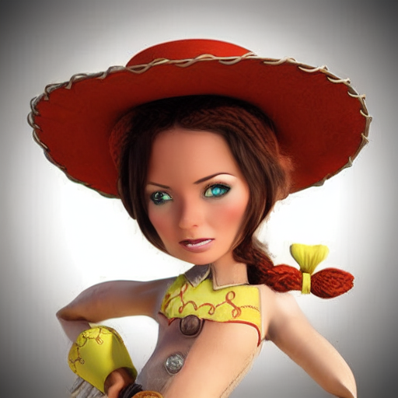
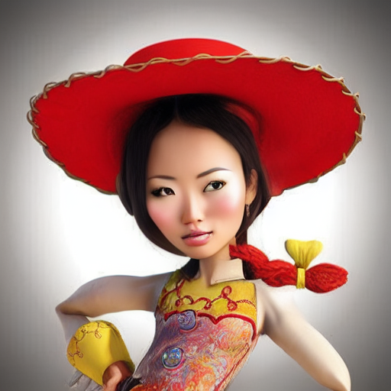

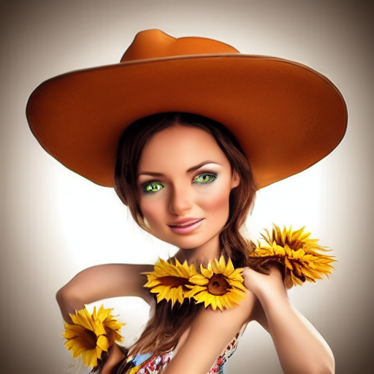


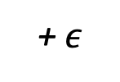
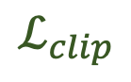
Visual Instruction Inversion: Image Editing via Visual Prompting
Thao Nguyen Yuheng Li Utkarsh Ojha Yong Jae Lee
University of Wisconsin - Madison
Motivation
Visual Instruction Inversion
Experiments Results
👍 Text-conditioned Image Editing is great!
A framework for inverting visual prompts
into editing instructions for text-to-image diffusion models.
⭐ Ours can learn the edit from {before, after} pair & offer additional advantages!
“make it
an
aerial photo”
Learning to
perform image editing
❓But, what if the desired edit is difficult to describe in words?
$$ℒ_{clip}$$
Before
InstructPix2Pix
+ $ε$
🔥
After
$$ℒ_{mse}$$
Before
After
Test
A
B
Learning to reconstruct image
Visual Prompt
⭐ “Turn it into a drawing” (language) can be ambiguous and ineffective.
Visual prompts can be more informative and intuitive to convey the desired edit
Leverage the CLIP embedding space
to help learn the editing direction
Before
After
Test
A
B
Visual Prompt
❓Can we use {before, after} pair to guide the edit? (Prompting)
Hybrid Instruction
Before
“Turn it into a brown cake”
“burning candle”
After
Tokenizer
Tokenizer
<|start|>
<ins> 🔥
<|end|>
[pad]
<|start|>
<ins>
<|end|>
[pad]
Test Image
<ins>
<ins> + “burning candle”
<ins> + “with orange slices”
(a) Instruction Optimization
(b) Instruction Concatenation
✏️ You can combine the learned instruction with a natural text prompt to create a hybrid instruction.
<ins>
+“… husky”
+ “… squirrel”
+ “… polar bear”
+ “… rabbit”
⭐ Achieve competitive results compared to SOTA text-conditioned image editing frameworks!
Before
After
Test Image
<ins>
+“…, female”
+ “…, Asian”
+ “…, female with a gun”
+ “..., female with sunflowers”
Before
After
Test Image
Project Page: https://thaoshibe.github.io/visii

